Slide 1
CHAPTER 6: The Little Man Computer
The Architecture of Computer Hardware, Systems Software & Networking: An Information Technology Approach
4th Edition, Irv Englander
John Wiley and Sons ©2010

Slide 2
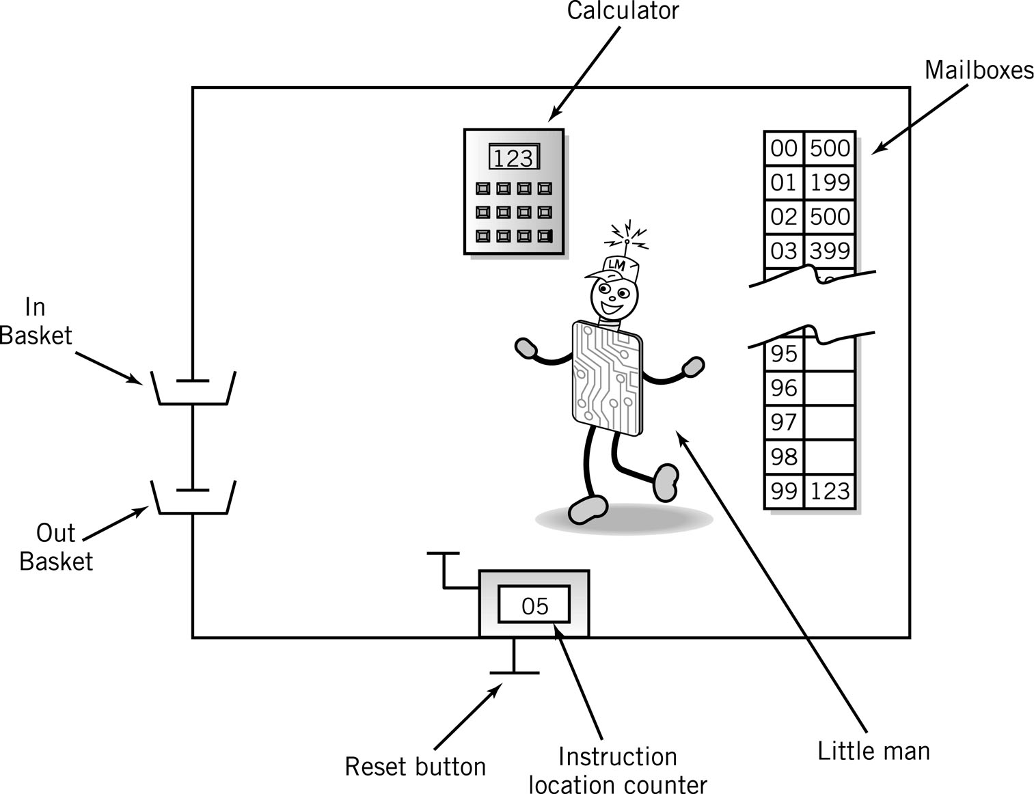
The Little Man Computer

Slide 3
Mailboxes: Address vs. Content
Addresses are consecutive starting at 00 and ending at 99
Content may be
Data, a three digit number, or
Instructions
Address | Content

Slide 4
Content: Instructions
Op code
In LMC, represented by a single digit
Operation code
Arbitrary mnemonic
Operand
In LMC, represented by two digits following the op code
Object to be manipulated
Data or
Address of data
Address | Content
 | Op code | Operand

Slide 5
Magic!
Load program into memory
Put data into In Basket

Slide 6
Assembly Language
Specific to a CPU
1 to 1 correspondence between assembly language instruction and binary (machine) language instruction
Mnemonics (short character sequence) represent instructions
Used when programmer needs precise control over hardware, e.g., device drivers

Slide 7
Instruction Set
Arithmetic | 1xx | ADD
 | 2xx | SUB
Data Movement | 3xx | STORE
 | 5xx | LOAD
Input/Output | 901 | INPUT
 | 902 | Output
Machine Control (coffee break) | 000 | HALT COB

Slide 8
Input/Output
Move data between calculator and in/out baskets
 |  | Content
 |  | Op Code | Operand (address)
IN (input) |  | 9 | 01
OUT (output) |  | 9 | 02

Slide 9
LMC Input/Output
IN
OUT

Slide 10
Internal Data Movement
Between mailbox and calculator
 |  | Content
 |  | Op Code | Operand (address)
STO (store) |  | 3 | xx
LDA (load) |  | 5 | xx

Slide 11
LMC Internal Data
LDA
STO

Slide 12
Arithmetic Instructions
Read mailbox
Perform operation in the calculator
 |  | Content
 |  | Op Code | Operand (address)
ADD |  | 1 | xx
SUB |  | 2 | xx

Slide 13
LMC Arithmetic Instructions
ADD
SUB

Slide 14
Data storage location
Physically identical to instruction mailbox
Not located in instruction sequence
Identified by DAT mnemonic

Slide 15
Simple Program: Add 2 Numbers
Assume data is stored in mailboxes with addresses >90
Write instructions
Input a #
Store the #
Input a #
Add
Output the
number

Slide 16
Program to Add 2 Numbers
Mailbox | Code | Instruction Description
00 | 901 | ;input 1st Number
01 | 399 | ;store data
02 | 901 | ;input 2nd Number
03 | 199 | ;add 1st # to 2nd #
04 | 902 | ;output result
05 | 000 | ;stop
99 | 000 | ;data

Slide 17
Program to Add 2 Numbers: Using Mnemonics
Mailbox | Mnemonic | Instruction Description
00 | IN | ;input 1st Number
01 | STO 99 | ;store data
02 | IN | ;input 2nd Number
03 | ADD 99 | ;add 1st # to 2nd #
04 | OUT | ;output result
05 | COB | ;stop
99 | DAT 00 | ;data

Slide 18
Program Control
Branching (executing an instruction out of sequence)
Changes the address in the counter
Halt
 |  | Content
 |  | Op Code | Operand (address)
BR (Jump) |  | 6 | xx
BRZ (Branch on 0) |  | 7 | xx
BRP (Branch on +) |  | 8 | xx
COB (stop) |  | 0 | (ignore)

Slide 19
LMC Instruction Set
Arithmetic | 1xx | ADD
 | 2xx | SUB
Data Movement | 3xx | STORE
 | 5xx | LOAD
BR | 6xx | JUMP
BRZ | 7xx | BRANCH ON 0
BRP | 8xx | BRANCH ON + or 0
Input/Output | 901 | INPUT
 | 902 | OUTPUT
Machine Control (coffee break) | 000 | HALT COB

Slide 20
Find Positive Difference of 2 Numbers
00 | IN | 901
01 | STO 10 | 310
02 | IN | 901
03 | STO 11 | 311
04 | SUB 10 | 210
05 | BRP 08 | 808 | ;test
06 | LDA 10 | 510 | ;if negative, reverse order
07 | SUB 11 | 211
08 | OUT | 902 | ;print result and
09 | COB | 000 | ;stop
10 | DAT 00 | 000 | ;used for data
11 | DAT 00 | 000 | ;used for data

Slide 21
Instruction Cycle
Fetch: Little Man finds out what instruction he is to execute
Execute: Little Man performs the work.

Slide 22
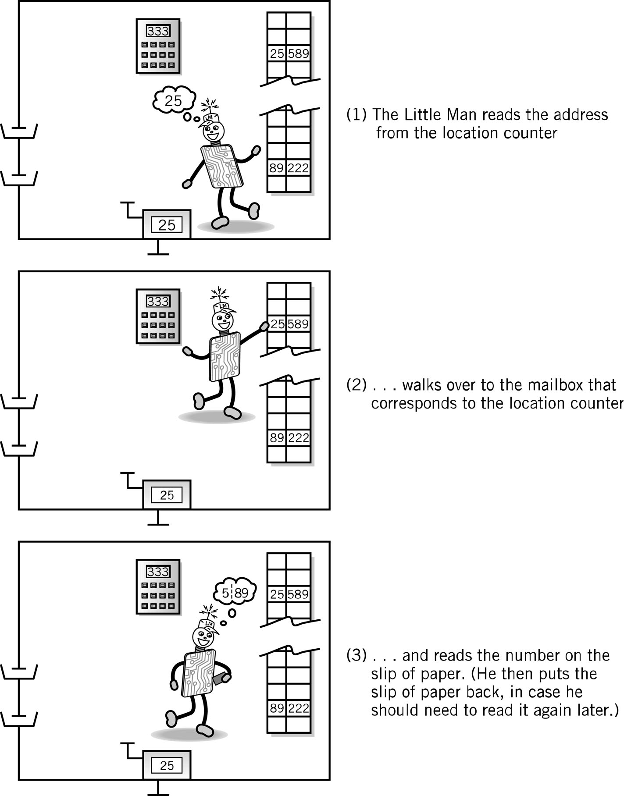
Fetch Portion of Fetch and Execute Cycle
1. Little Man reads the address from the location counter
2. He walks over to the mailbox that corresponds to the location counter

Slide 23
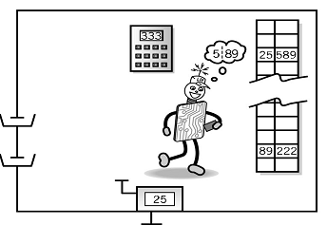
Fetch, cont.
3. And reads the number on the slip of paper (he puts the slip back in case he needs to read it again later)

Slide 24
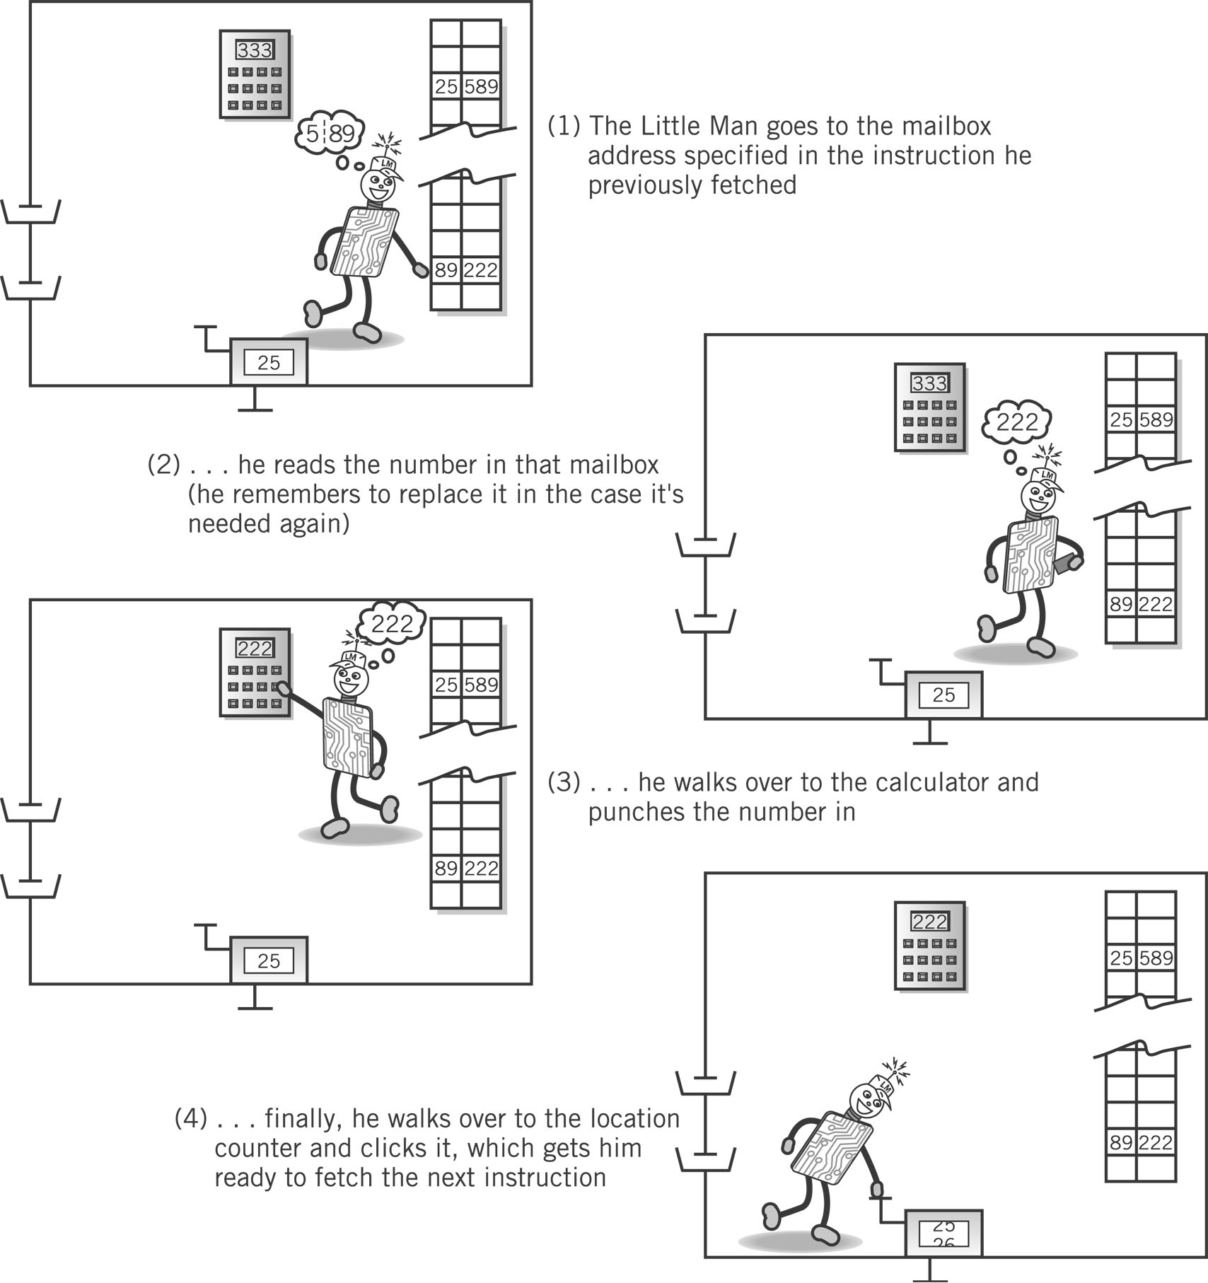
Execute Portion
1. The Little Man goes to the mailbox address specified in the instruction he just fetched.
2. He reads the number in that mailbox (he remembers to replace it in case he needs it later).

Slide 25
Execute, cont.
3. He walks over to the calculator and punches the number in.
4. He walks over to the location counter and clicks it, which gets him ready to fetch the next instruction.

Slide 26
von Neumann Architecture (1945)
Stored program concept
Memory is addressed linearly
Memory is addressed without regard to content

